Slide 1
Introduction
Outline
  Statistical Multiplexing
  Inter-Process Communication
  Network Architecture
  Performance Metrics

Slide 2
Building Blocks
Nodes: PC, special-purpose hardware…
  hosts
  switches
Links: coax cable, optical fiber…
  point-to-point
  multiple access
…

Slide 3
Switched Networks
A network can be defined recursively as...
  two or more nodes connected by a link, or
  two or more networks connected by two or more nodes

Slide 4
Strategies
Circuit switching: carry bit streams
  original telephone network
Packet switching: store-and-forward messages
  Internet

Slide 5
Addressing and Routing
Address: byte-string that identifies a node
  usually unique
Routing: process of forwarding messages to the destination node based on its address
Types of addresses
  unicast: node-specific
  broadcast: all nodes on the network
  multicast: some subset of nodes on the network

Slide 6
Multiplexing
Time-Division Multiplexing (TDM)
Frequency-Division Multiplexing (FDM)
L1
R1
L2
R2
Switch 1
Switch 2
L3
R3

Slide 7
Statistical Multiplexing
On-demand time-division
Schedule link on a per-packet basis
Packets from different sources interleaved on link
Buffer packets that are contending for the link
Buffer (queue) overflow is called congestion
…

Slide 8
Inter-Process Communication
Turn host-to-host connectivity into process-to-process communication.
Fill gap between what applications expect and what the underlying technology provides.
Host
Host
Application
Host
Channel
Application
Host
Host

Slide 9
IPC Abstractions
Request/Reply
  distributed file systems
  digital libraries (web)
Stream-Based
  video: sequence of frames
    1/4 NTSC = 352x240 pixels
    (352 x 240 x 24)/8=247.5KB
    30 fps = 7500KBps = 60Mbps
  video applications
    on-demand video
    video conferencing

Slide 10
What Goes Wrong in the Network?
Bit-level errors (electrical interference)
Packet-level errors (congestion)
Link and node failures
Messages are delayed
Messages are deliver out-of-order
Third parties eavesdrop

Slide 11
Layering
Use abstractions to hide complexity
Abstraction naturally lead to layering
Alternative abstractions at each layer
Application programs
Request/reply
Message stream
channel
channel
Host-to-host connectivity
Hardware

Slide 12
Protocols
Building blocks of a network architecture
Each protocol object has two different interfaces
  service interface: operations on this protocol
  peer-to-peer interface: messages exchanged with peer
Term “protocol” is overloaded
  specification of peer-to-peer interface
  module that implements this interface

Slide 13
Interfaces
Host 1
Host 2
High-level
Service
High-level
object
interface
object
Protocol
Peer-to-peer
Protocol
interface

Slide 14
Protocol Machinery
Protocol Graph
  most peer-to-peer communication is indirect
  peer-to-peer is direct only at hardware level
Host 1
Host 2
File
Digital
Video
File
Digital
Video
application
library
application
application
library
application
application
application
RRP
MSP
RRP
MSP
HHP
HHP

Slide 15
Machinery (cont)
Multiplexing and Demultiplexing (demux key)
Encapsulation (header/body)
Host 1
Host 2
Application
Application
program
program
Data
Data
RRP
RRP
RRP
Data
RRP
Data
HHP
HHP
HHP
RRP
Data

Slide 16
Internet Architecture
Defined by Internet Engineering Task Force (IETF)
Hourglass Design
Application vs Application Protocol (FTP, HTTP)
FTP
HTTP
NV
TFTP
TCP
UDP
IP
NET
…
NET
1
2
NET
n

Slide 17
ISO Architecture
End host
End host
Application
Application
Presentation
Presentation
Session
Session
Transport
Transport
Network
Network
Network
Network
Data link
Data link
Data link
Data link
Physical
Physical
Physical
Physical
One or more nodes
within the network

Slide 18
Performance Metrics
Bandwidth (throughput)
  data transmitted per time unit
  link versus end-to-end
  notation
    KB = 2¹⁰ bytes
    Mbps = 10⁶ bits per second
Latency (delay)
  time to send message from point A to point B
  one-way versus round-trip time (RTT)
  components
    Latency = Propagation + Transmit + Queue
    Propagation = Distance / c
    Transmit = Size / Bandwidth

Slide 19
Bandwidth versus Latency
Relative importance
  1-byte: 1ms vs 100ms dominates 1Mbps vs 100Mbps
  25MB: 1Mbps vs 100Mbps dominates 1ms vs 100ms
Infinite bandwidth
  RTT dominates
    Throughput = TransferSize / TransferTime
    TransferTime = RTT + 1/Bandwidth x TransferSize
  1-MB file to 1-Gbps link as 1-KB packet to 1-Mbps link

Slide 20
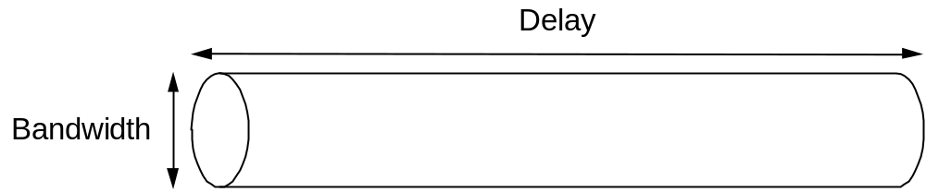
Delay x Bandwidth Product
Amount of data “in flight” or “in the pipe”
Example: 100ms x 45Mbps = 560KB

